Slide 1
Table of contents
01
02
Cleaning
Visualization
You can describe the topic of the section here
You can describe the topic of the section here

Slide 2
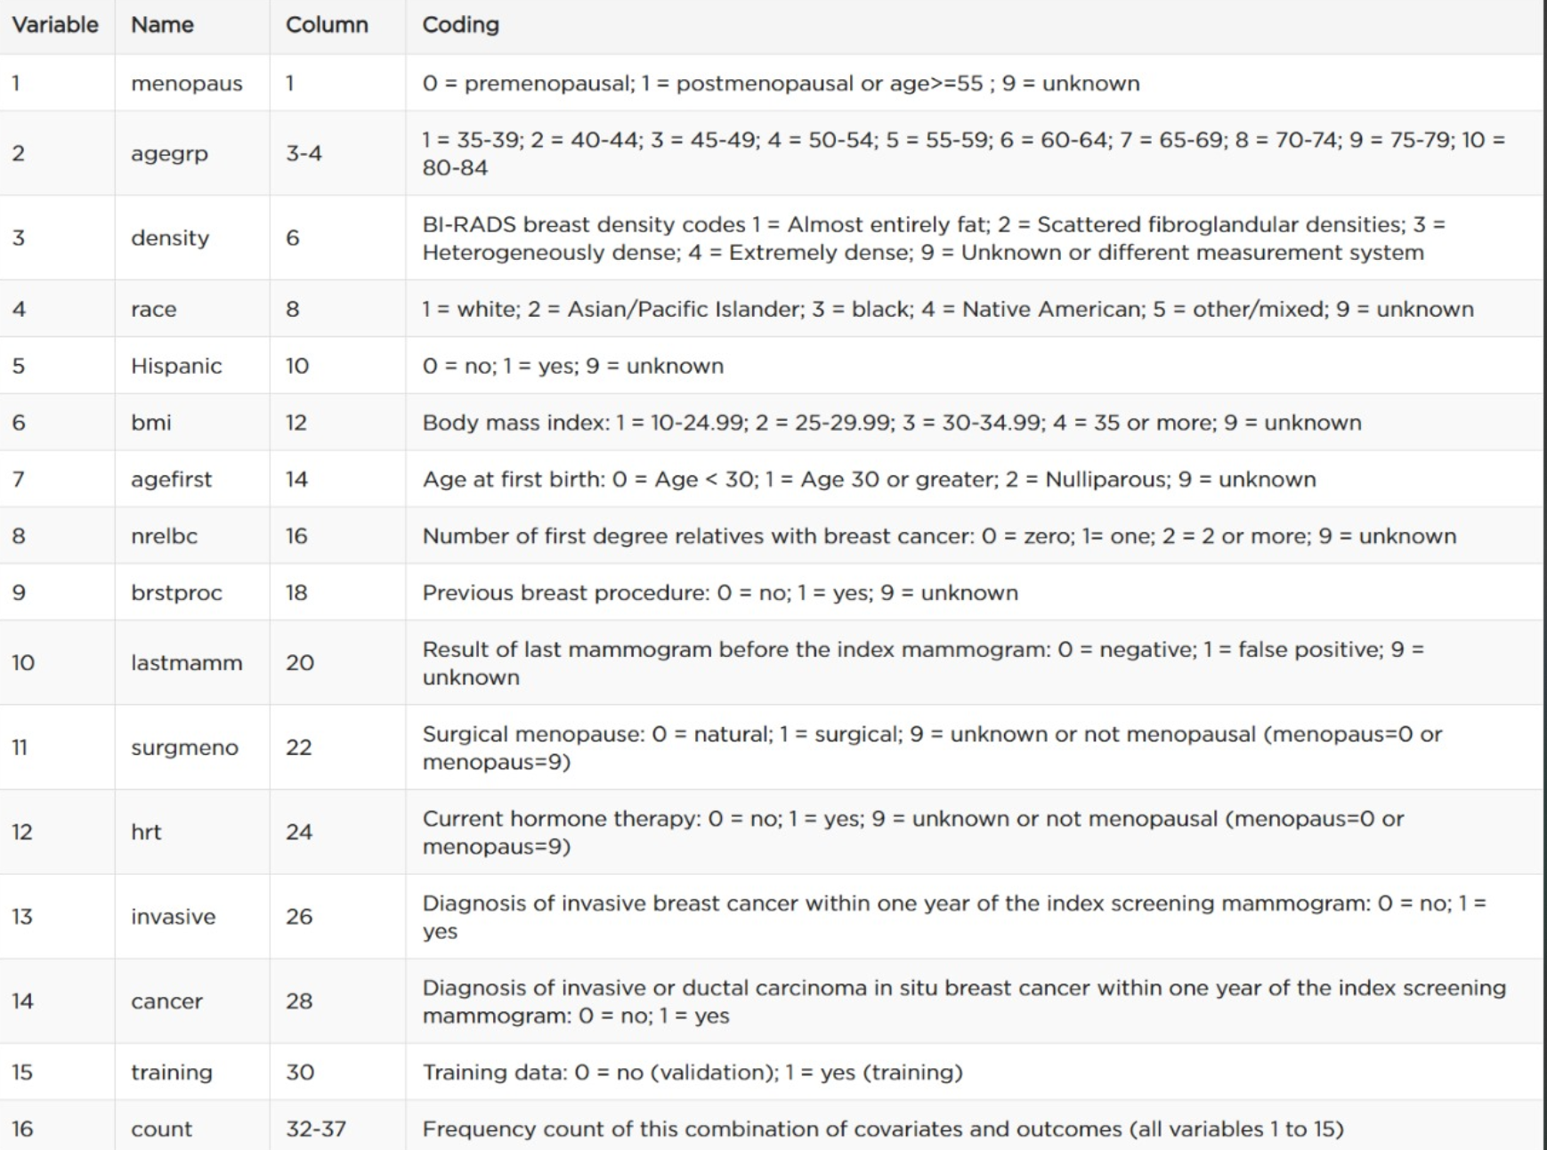
Introduction

Slide 3
Data Cleaning
Removing Null values
Refining Null values
Drop any row with 0 count

Slide 4
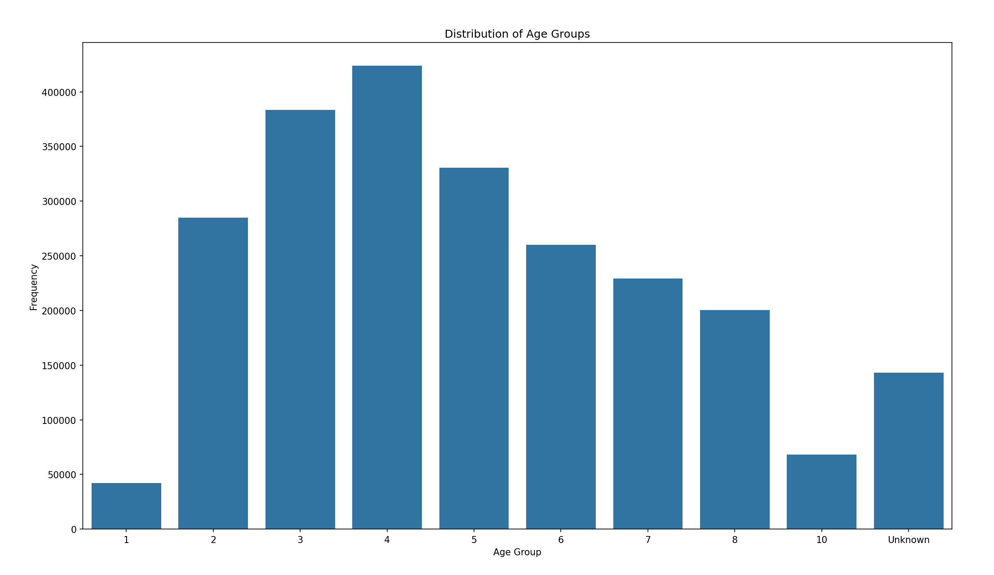

Slide 5
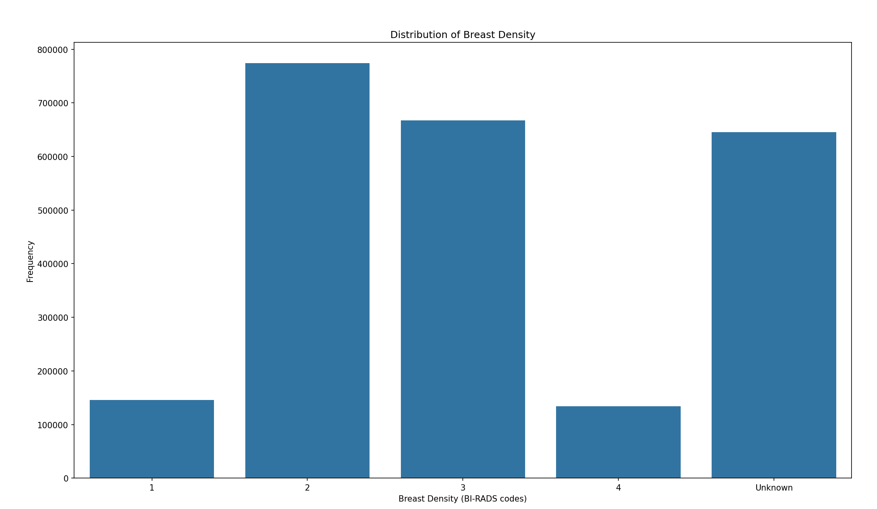

Slide 6
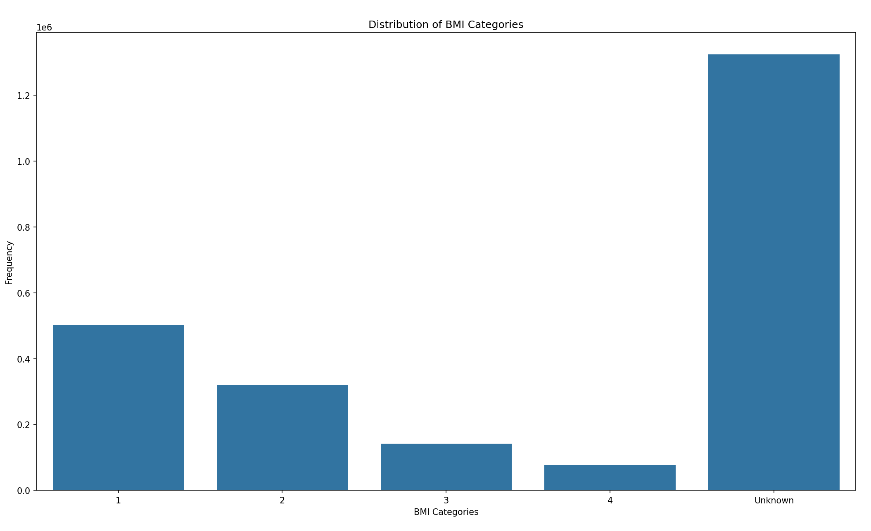

Slide 7
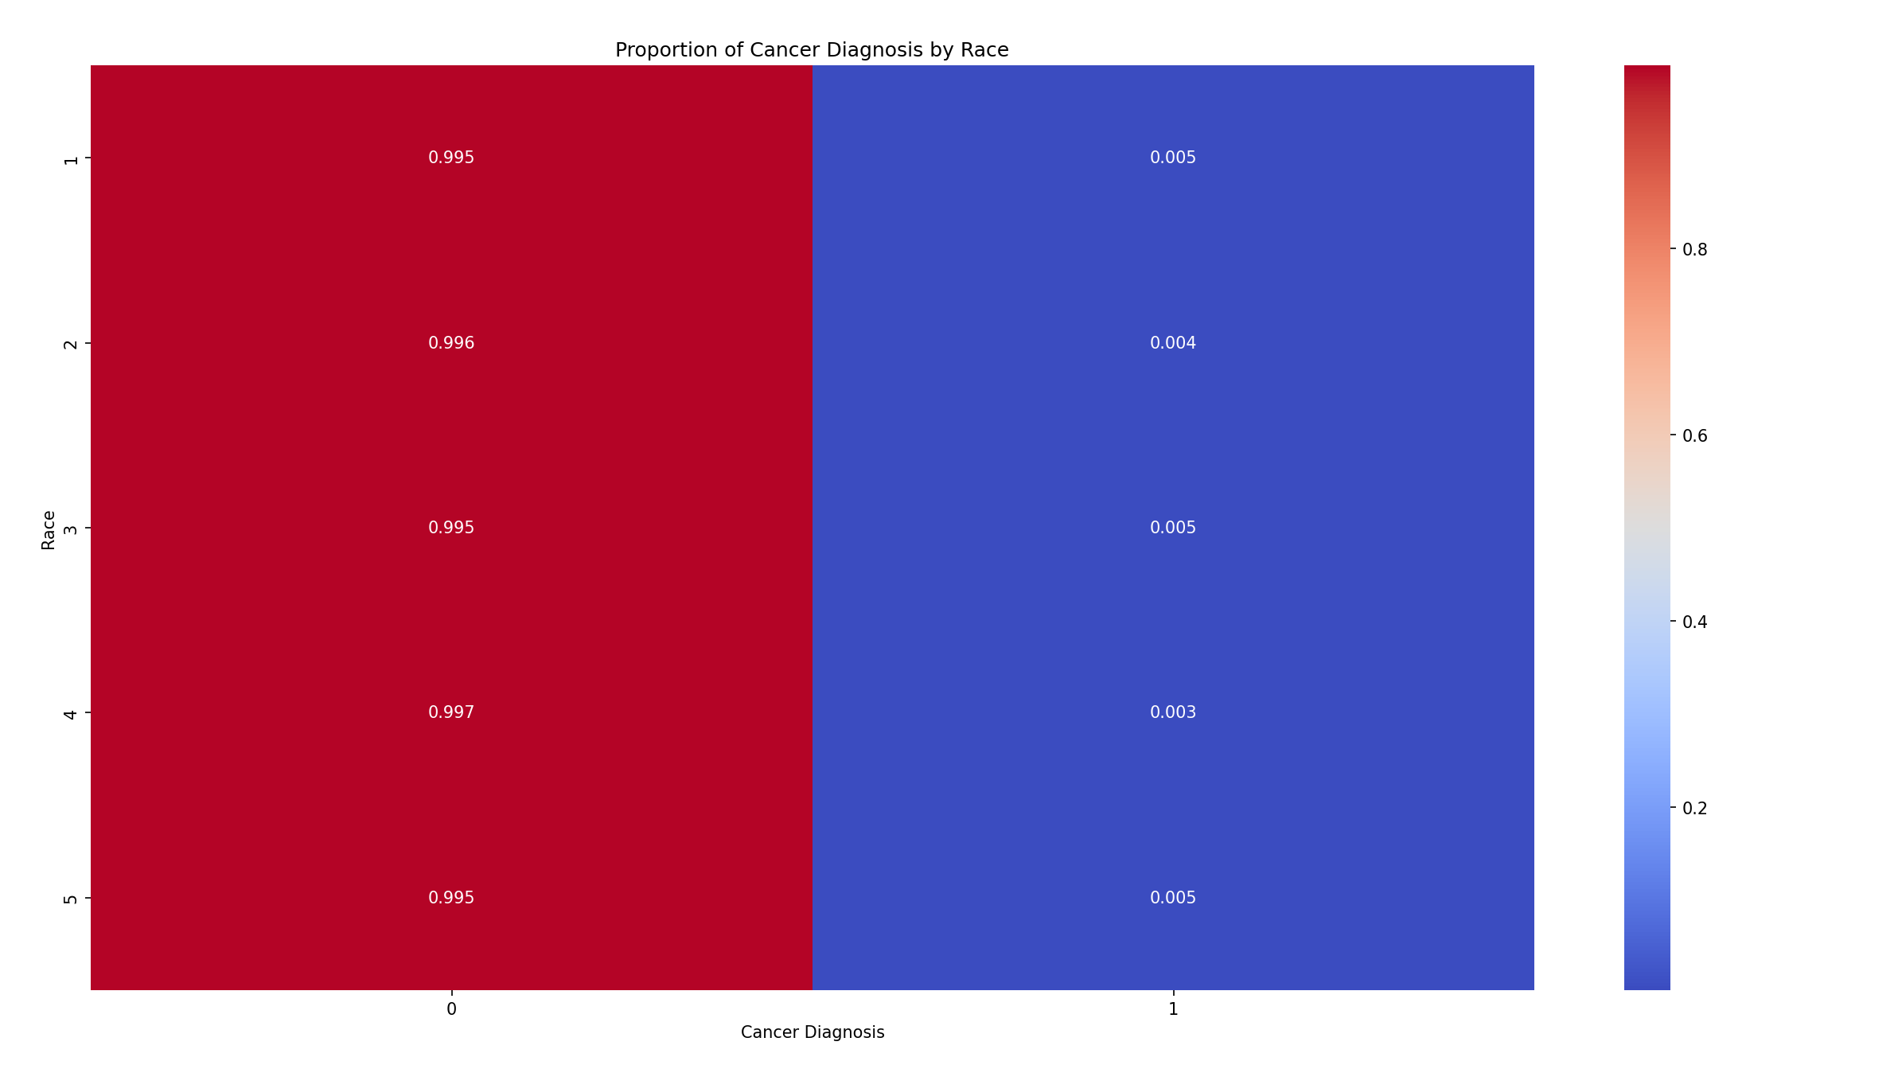

Slide 8
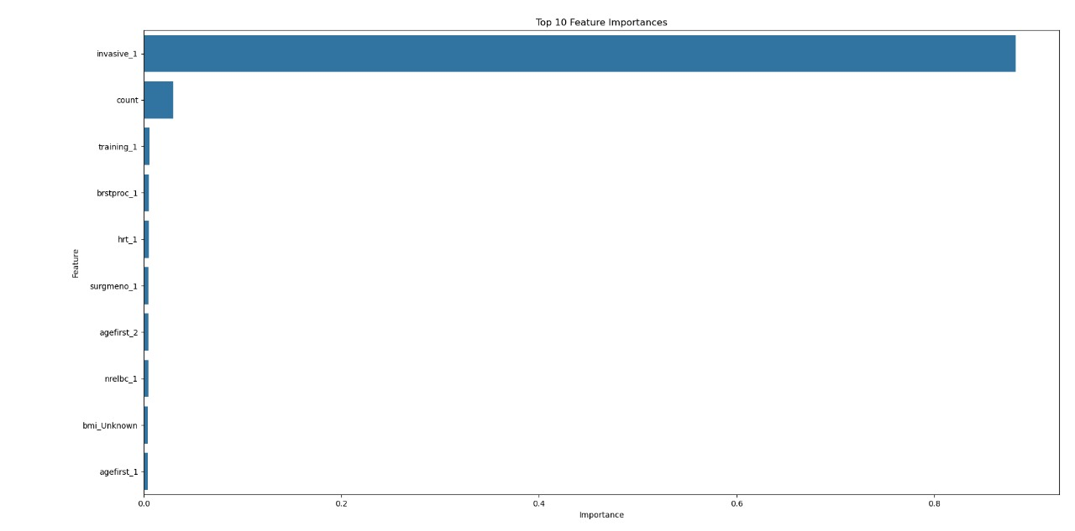
Model training
Top 10 coefficients:

Slide 9
the F1-score is 0.88 Confusion Matrix: True Negatives (470,841): No cancer correctly predicted. True Positives (1,797): Cancer correctly predicted. False Negatives (450): Cancer cases missed. False Positives (47): Cases predicted as cancer incorrectly.
Classification Report:

Slide 10
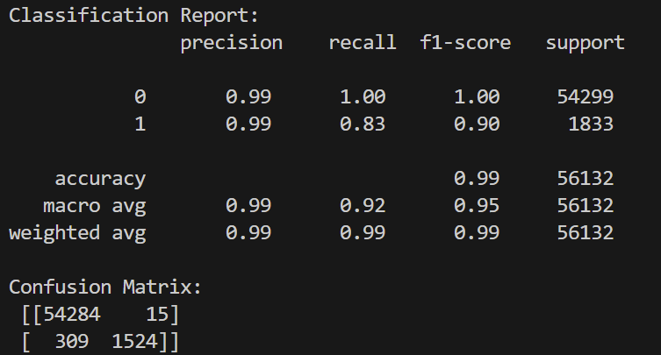
Model training
For predictions:
True Negatives (TN): 54,284 cases were correctly predicted as class 0 (no cancer).
False Positives (FP): 15 cases were incorrectly predicted as class 1 (cancer) when they were actually class 0.
False Negatives (FN): 309 cases were incorrectly predicted as class 0 (no cancer) when they were actually class 1.
True Positives (TP): 1,524 cases were correctly predicted as class 1 (cancer).

Slide 11
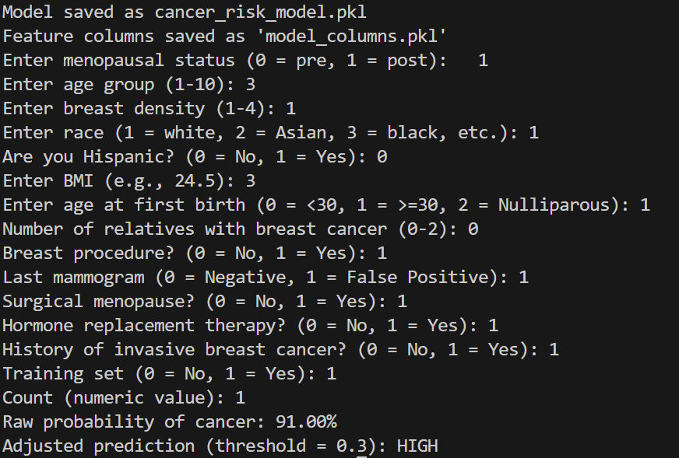
User input:

